Slide 1
The Lottery Ticket Hypothesis (LTH)
David Assaraf, Gael Ancel, Tale Lokvenec, Raphael Pellegrin
CS205 2021
05/10/2021

Slide 2
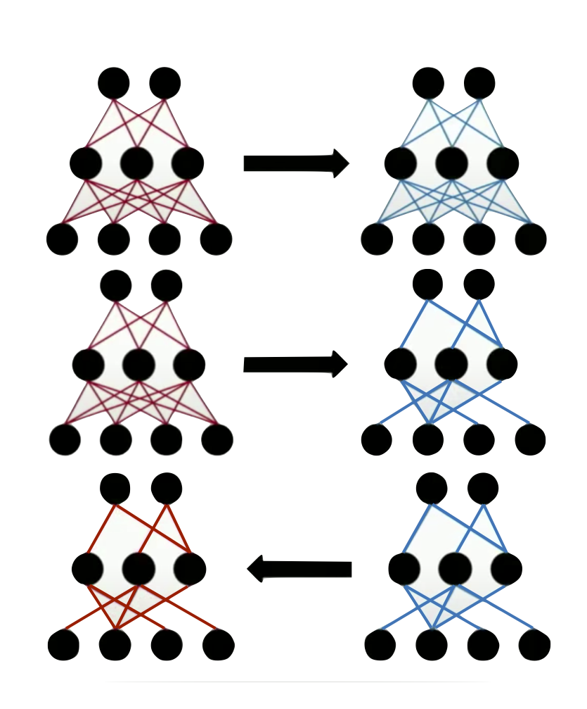
LTH
I - Problem Statement: Overview of the LTH
The LTH builds on the notion of network pruning, which is used to reduce the storage costs and computational requirements of dealing with the network. The pruning algorithm proposed is called Iterative Magnitude Pruning (IMP):
Begin with a Neural Network where each connection has been set to a random weight.
Train the Neural Network
Given a threshold t, remove the superfluous structure by pruning weights (sparse pruning): look at the magnitude of the weights and prune the weights with magnitude lower than the threshold.
Reset the remaining weights to their value at a given epoch of choice, and we retrain the sparse subnetwork until the end.
The objective of this procedure is to find the most sparse sub architecture (called the winning ticket) of the initial Neural Network that will match the initial generalization ability. Studies also showed that this ticket generalizes across dataset.
Notes:
Overview: the Lottery Ticket Hypothesis (LTH)
Our project is based on the paper: The Lottery Ticket Hypothesis: Finding Sparse, Trainable Neural Networks by Jonathan Frankle and Michael Carbin. The Lottery Ticket Hypothesis (LTH) builds on the notion of network pruning. The idea is to reduce the extent [of a neural network] by removing superfluous or unwanted parts. Network pruning is used to reduce the storage costs and computational requirements of dealing with the network.
The basic idea of the LTH is the following. Initially, we begin with a Neural Network where each connection has been set to a random weight. We the train the Neural Network and remove the superfluous structure. Here, we focus on pruning weights: this is called sparse pruning. We look at the magnitude of the weights and we prune the weights with the lowest magnitude. We then reset the remaining weights to their initial value - or to their value at a given epoch - and we retrain the sparse subnetwork. It’s important to reset the weights to their original value or to a value they took during training and not to random values.
Once we have pruned the Neural Network, we have damaged the function that we have learnt. We thus perform some fine tuning (further training).
We then arrive at networks that are 15% to 1% of their original size. Those sub-networks require fewer iterations to learn and they match the accuracy of the original network.
There is a great talk by Jonathan Frankle at ICLR2019 that summarises these ideas: J. Frankle & M. Carbin: The Lottery Ticket Hypothesis: Finding Sparse, Trainable Neural Networks.
We have two loops to parallelize: we first need to study different possible thresholds for our masks (a bigger threshold means that we throw away more weights). We also need to decide on the epoch N which we will use as our baseline when we reset the weights of our subnetwork.
Note that it is also possible to do the pruning procedure iteratively: this is called Iterative Magnitude Pruning in the paper.
The original paper only provides experiments for MNIST and CIFAR-10, which are relatively small datasets.

Slide 3
IMP Algorithm
I - Problem Statement: two loops to parallelize
We have two loops to parallelize:
study different possible thresholds for our masks (a bigger threshold means that we throw away more weights).
decide on the five epochs which we will use as our ‘late resetting’ when we reset the weights of our subnetwork (ie a masked network).
Thresholds: we trained our initial architecture and studied the magnitude of the weights. We decided to keep the 65, 70, 75, 80, 85, …, 99 percentiles as our thresholds.
For example, using the 65 percentile as a threshold, we throw away 65 percent of the weights and are left with a subnetwork whose size is 35 percent of the size original Neural Network.
We keep subnetworks that are between 1% and 35% of the original size and retrain them independently from epochs 5, 10, 15, 20, 25

Slide 4
IMP Complexity
I - Problem Statement: Numerical complexity
The numerical complexity of doing late-resetting and masking is O(MNt)=O(100t).
M=20 is the number of thresholds for our masks (each mask gives us one subnetwork). For every masked architecture, we need to perform several trainings from several epochs
N=5 is the length of the trellis for late resetting
t is the average time to train a network (we actually use sparse subnetworks, so they train faster than the original one). t = 26 h 15 min
Amdahl’s law states that we have a theoretical speed up of 20.
Notes:
We use 20 worker nodes. Each worker needs to do several late resetting for the particular structure found after masking. Afterwards, there is no communication between the worker nodes. The communication time at the beginning is negligible compared to training time. The computation time per epoch is 4.5 minutes at best. We have 350 epochs, and perform 5 late resetting. Thus we achieve a run time of 131 h 15 min at best per worker node. This corresponds to a speed up of 20.
Amdahl Law (1967)
Parallel execution Speed-up and Efficiency for a given problem size and a number of processors are given by:
In our case S=20 and E=1.
CPU and GPU training
We use the following link to train on multiple GPUs: https://towardsdatascience.com/train-a-neural-network-on-multi-gpu-with-tensorflow-42fa5f51b8af.
tf.distribute.Strategy
is a TensorFlow API to distribute training across multiple GPU. We use the mirrored stratedy which send splits the batches and sends them to the four different GPUs.
We bring down the time with GPUs:
With 4 GPUs and a batch size of 96:
GPU occupancy
" A CUDA device's hardware implementation groups adjacent threads within a block into warps. A warp is active from the time its threads begin executing to the time when all threads in the warp have exited from the kernel. Occupancy is the ratio of active warps on an SM to the maximum number of active warps supported by the SM. Occupancy varies over time as warps begin and end, and can be different for each SM. "
Source: https://docs.nvidia.com/gameworks/content/developertools/desktop/analysis/report/cudaexperiments/kernellevel/achievedoccupancy.htm
Increasing the GPU occupancy
We see that initially, the GPU occupancy is 0%. At this stage, the bottleneck of our architecture was the preprocessing, which prevented our GPUs from efficiently accessing the data. Besides, we couldn't do the batching before the mapping because of the inconsistencies of size in ImageNet. The first step we took to adress this issue was to transform the data to shapes of (64, 64). With image sizes of (64, 64), one epoch runs for 15 mins while for shapes of (224, 224) one epoch took 1h. Need to do some preprocessing here.After resolving the preprocessing issues, we manageed to increase the GPU occupancy:
Finally, we were able to reach 100% GPU occupancy.
Spark for offline processing of the data
We reshaped the data as tf tensors before loading it.

Slide 5

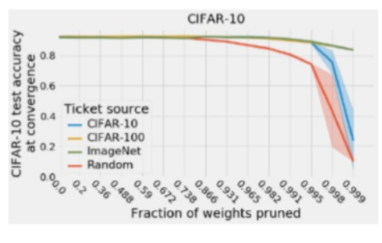
Big Data: ImageNet
II - Need for Big Data: ImageNet
ImageNet Dataset:
Total number of training images: 1.23M
Total number of validation images: 100k
Total number of test images: 50k
Size: 157.3 GB
Average image resolution (downloaded): 469x387
Average image resolution (preprocessed): 227x227
Why ImageNet ?
Winning tickets are generalizable across datasets
Big datasets like ImageNet will result in a very general winning ticket

Slide 6
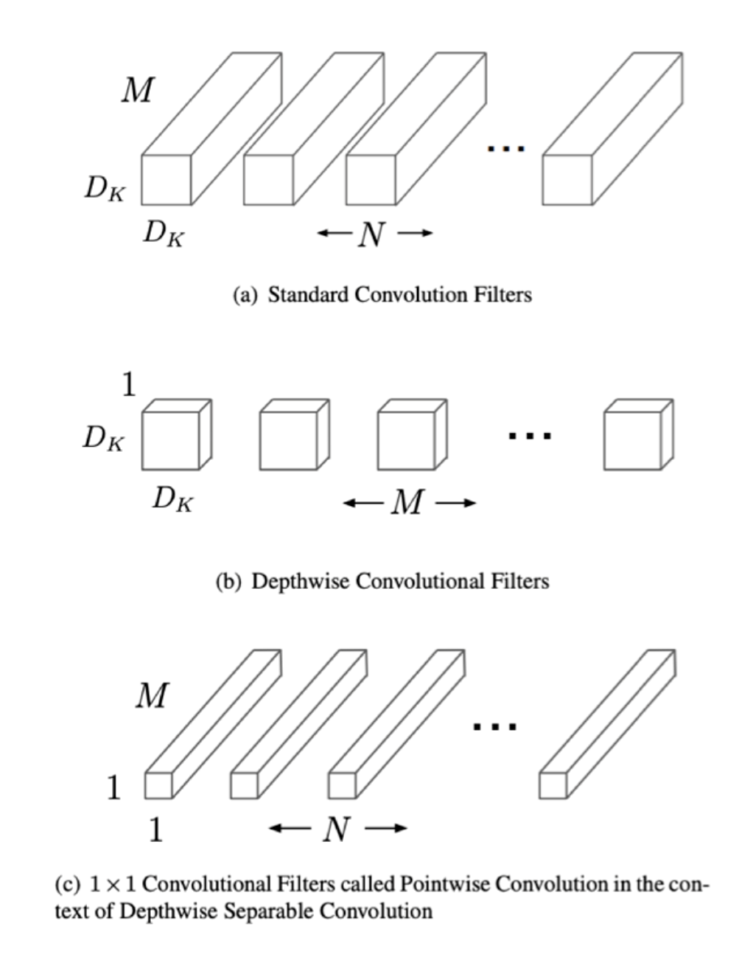
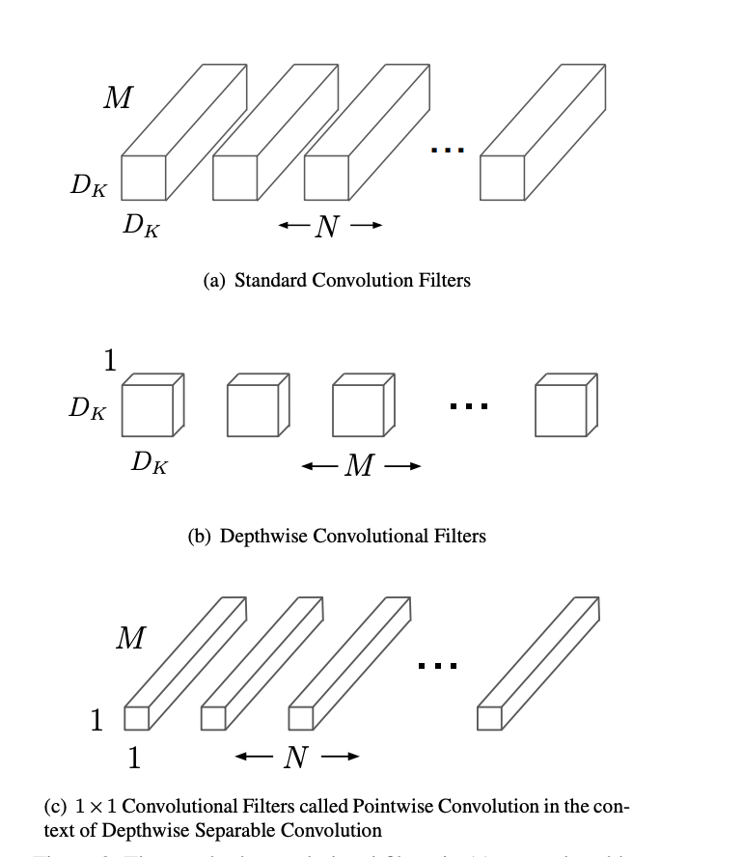
Big Compute: MobileNet
II - Need for Big Compute: MobileNet
MobileNetV2 Architecture:
Depthwise separable convolutions instead of regular convolution
Total number of parameters: 3.4M
Number of multiply-adds (MAdds) per forward pass: 300M
→ GPU Accelerated Computing (4 GPUs single worker node)
Two Nested For Loops to find the Lottery Ticket Hypothesis
Outer for loop: iterate over different masks (pruning thresholds)
Inner for loop: iterate over the range of late resetting epochs
Train a sparse MobileNetV2 CNN per each inner loop iteration
→ Distributed Computing (20 worker nodes)
Why MobileNet ?
Need Deep Architectures in order to extract relevant features
Computational savings vs other usual architectures

Slide 7


Infrastructure
III - Programming model and infrastructure
We use FAS RC (take advantage of the SCRATCH space [300+GB] and the ease of allocating several nodes for MPI).
Python 3.8.5, mpi4py 3.0.3, pyspark 3.1.1, Apache maven 3.8.1, java 1.8.0_45
We used Spark-Tensorflow connector and Standalone Spark mode to convert the data from TF Tensors to RDD and process it in an offline manner
We use SLURM Job Arrays for communication between our nodes and Python Multiprocessing for parallelization within a node
Train using TensorFlow 2.0 (leveraging cuda and cudnn)
Objective: End solution comprises 20 worker nodes, each one will have 4 GPUs TESLA K80 with 11.5 GB memory and 64 CPUs
Notes:
David

Slide 8
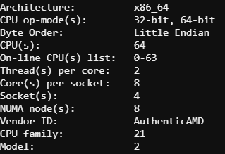
Single CPU
IV - Effective Parallelization of the Training of a CNN on Large Scale Data
Learning Hyperparameters and their influence on the training time:
Batch size : arbitrary
Learning Rate : arbitrary
Number of Epochs : 100
1 epoch = 20 hours
1 model = 100 epochs = 2000 hours
100 models = 200000 hours = ~8000 days
Notes:
Tale

Slide 9
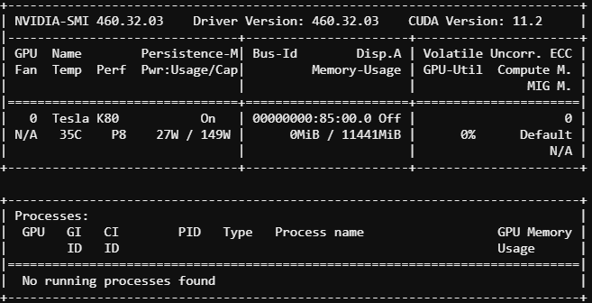
Single GPU
IV - Effective Parallelization of the Training of a CNN on Large Scale Data
Learning Hyperparameters and their influence on the training time:
Batch size : arbitrary
Learning Rate : arbitrary
Number of Epochs : 100
1 epoch = 4 hours
1 model = 100 epochs = 400 hours
100 models = 40000 hours = ~1650 days
Notes:
Tale

Slide 10
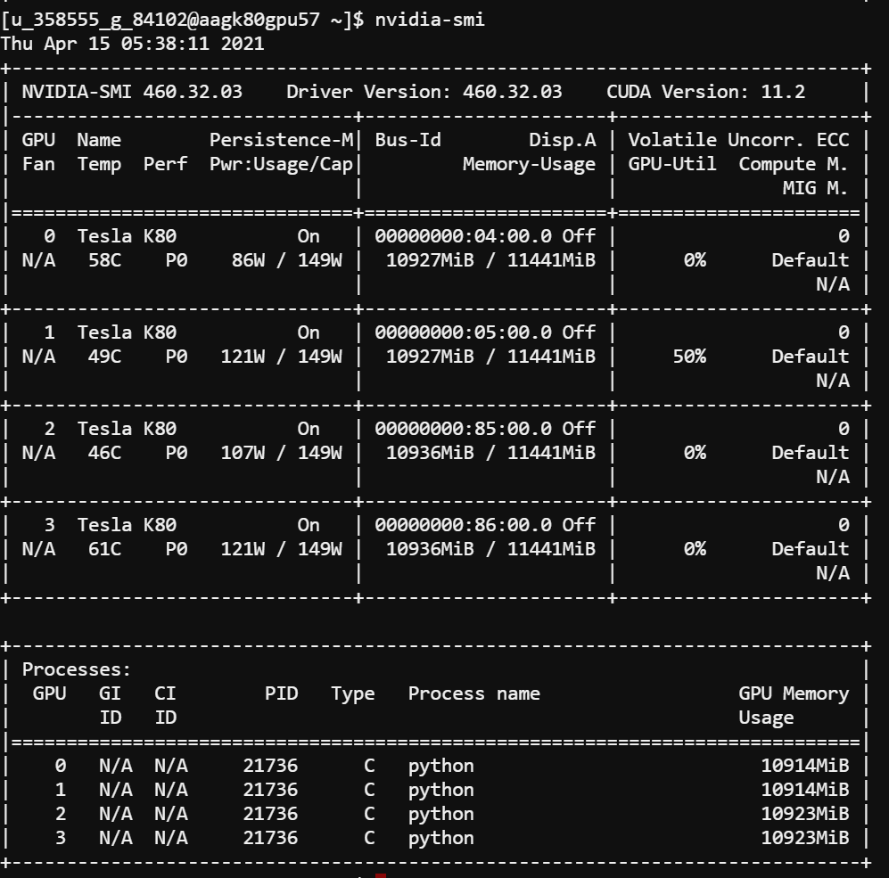
4 GPUs
IV - Effective Parallelization of the Training of a CNN on Large Scale Data
Learning Hyperparameters and their influence on the training time:
Batch size : arbitrary
Learning Rate : arbitrary
Number of Epochs : 100
1 epoch = 1 hour
1 model = 100 epochs = 100 hours
100 models = 10000 hours = ~400 days
Notes:
Tale

Slide 11
Ineffective 4 GPUs
IV - Effective Parallelization of the Training of a CNN on Large Scale Data
Learning Hyperparameters and their influence on the training time:
Batch size : arbitrary
Learning Rate : arbitrary
Number of Epochs : 100
Parallelization Strategy: Mirrored Strategy
1 epoch = 1 hour
1 model = 100 epochs = 100 hours
100 models = 10000 hours = ~400 days
Notes:
Tale

Slide 12
Accelerating data pipeline
IV - Effective Parallelization of the Training of a CNN on Large Scale Data
Learning Hyperparameters and their influence on the training time:
Batch size : arbitrary
Learning Rate : arbitrary
Number of Epochs : 100
Bottleneck identified: our data pipeline is too slow in order to process and feed the data to the GPU (diagnosis: the GPUs are idle)
First step: accelerating the data pipeline
Notes:
Tale

Slide 13
Pipeline Acceleration
IV - Effective Parallelization of the Training of a CNN on Large Scale Data: 4 GPUs case
Learning Hyperparameters and their influence on the training time:
Batch size: arbitrary
Learning Rate: arbitrary
Number of Epochs : 100
Pipeline changes
Parallelizing the preprocessing operations in the data pipeline (dynamic allocation of #workers)
Caching and Prefetching the data in order to reduce the data transfers between CPU & GPU
Notes:
Tale

Slide 14
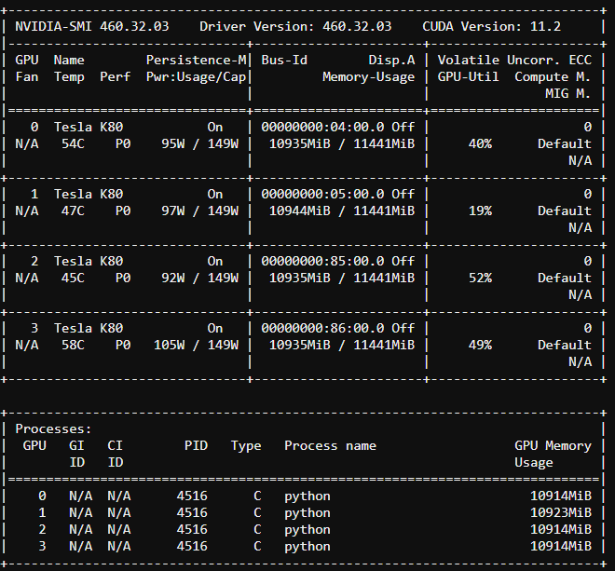
Towards 100% occupation ?
IV - Effective Parallelization of the Training of a CNN on Large Scale Data: 4 GPUs case
Learning Hyperparameters and their influence on the training time:
Batch size : 512 (objective: saturate the GPU memory at every data bus)
Learning Rate : arbitrary
Number of Epochs : 100
1 epoch = 23 minutes
1 model = 100 epochs = ~38 hours
100 models = ~150 days
Can we reach ~100% GPU occupation ?
Notes:
Tale

Slide 15
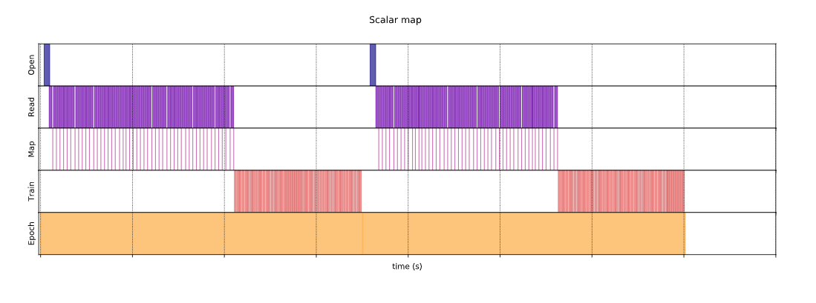
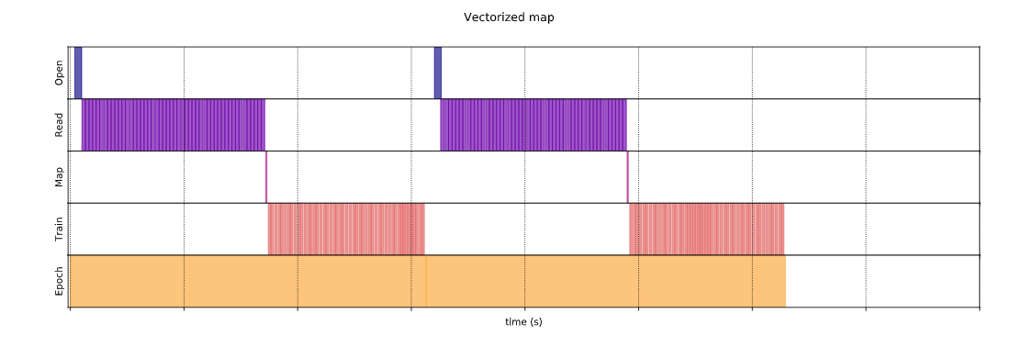
Vectorizing Transformations
IV - Effective Parallelization of the Training of a CNN on Large Scale Data
Learning Hyperparameters and their influence on the training time:
Batch size : 512 (objective: saturate the GPU memory at every data bus)
Learning Rate : arbitrary
Number of Epochs : 100
Solution chosen: vectorizing the preprocessing functions across a batch (ie first batching, then apply transformations)
Toy example with a special subset of the data:
Notes:
Tale

Slide 16
Need for Spark
IV - Effective Parallelization of the Training of a CNN on Large Scale Data
Issue: can’t batch ImageNet because of non uniform shapes of Images
Solution: offline preprocessing Step, using either TFDS pipeline or Spark
Problems using Spark: the data is loaded as TF Records and not as .PNG files
Solution: Use a Spark Tensorflow Connector in order to load the TF Records as Spark DataFrames (requires using maven)
Using Spark pipelining: process 1024 images in 12 seconds
Using TFDS pipelining: process 1024 images in 38 seconds
Effective Data processing Speed up using spark: ~3 x
Notes:
Our plans were also to be Using Elephas for Spark should we need further acceleration in the training
Data was stored as TF Tensors in order to gain memory + speed up when loading the data in tensorflow (TF Record is the native data format).
1024 folders of 1024 images

Slide 17
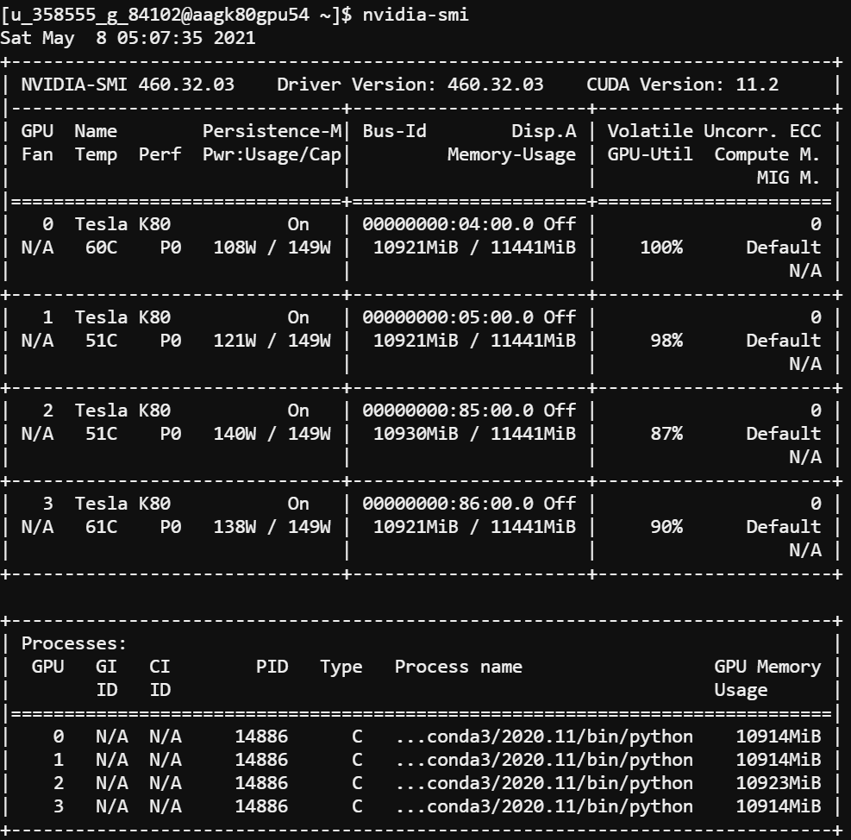
Final Result
IV - Effective Parallelization of the Training of a CNN on Large Scale Data
Using the data already preprocessed:
1 epoch = 11 minutes
1 model = 100 epochs = ~18 hours
100 models = ~75 days
Effective Speed-up from Single CPU: ~x100
Notes:
Our plans were also to be Using Elephas for Spark should we need further acceleration in the training
Data was stored as TF Tensors in order to gain memory + speed up when loading the data in tensorflow (TF Record is the native data format).
1024 folders of 1024 images

Slide 18
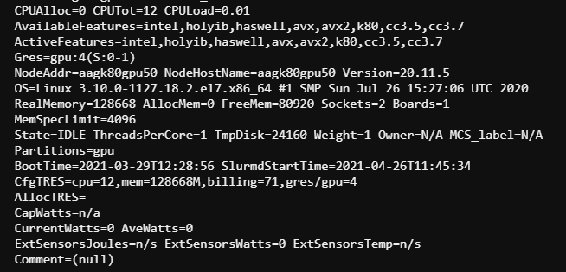
From MPI To SLURM
IV - Effective Parallelization of Masking: Distributed Memory Parallel Programming
Issue: Distributed Memory Parallel Computing Paradigm involves some overheads in the communication between different nodes
Solution: Transform our problem into a SIMD paradigm and use SLURM Job arrays in order to parallelize the work without communication.
Setting: We parallelized over 20 workers nodes (two cascades of 10 worker nodes with 4 GPUs)
Notes:
Advantage: effective speed-up = theoretical speed-up

Slide 19
The Problem
V - Within Node Code Optimization
Pruning the MobileNet architecture using Tensorflow
Issue: pruning weights using a mask in tensorflow damages the computational graph
Solution: zeroing the weights using a mask on each batch using tf.callbacks
Code Profiling
Results from code profiling
Tf.callbacks: 3.3457s
Total batch time (including tf.callbacks): 3.5970s
Tf.callbacks: ~93% of batch runtime
Issue: the influence of tf.callbacks on the training time
Solution: stay tuned!!

Slide 20
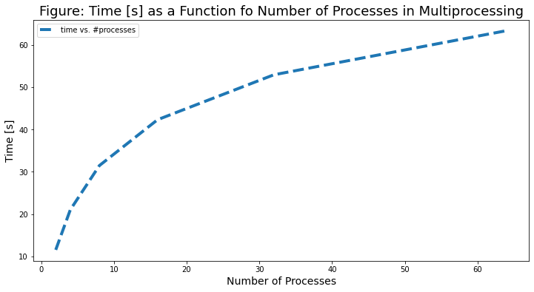
Single Process vs. Multiprocessing
V - Within Node Code Optimization
Optimizing the tf.callbacks
Single Process
Tf.callbacks on a single process: 3.3457s
Multiprocessing
Tf.callbacks on 64 processes: 63.3417s
Why is multiprocessing (MP) slowing down our code?
Computation time increase with # processes
Calling os.fork() at least 64 times!
Creating a child process expensive (overhead)
# trainable layers 155: ~ 3 tasks per process
Tasks simple: matrix multiplication
Overheads MP >> benefits MP
Conclusion: MP not a suitable solution for problem

Slide 21
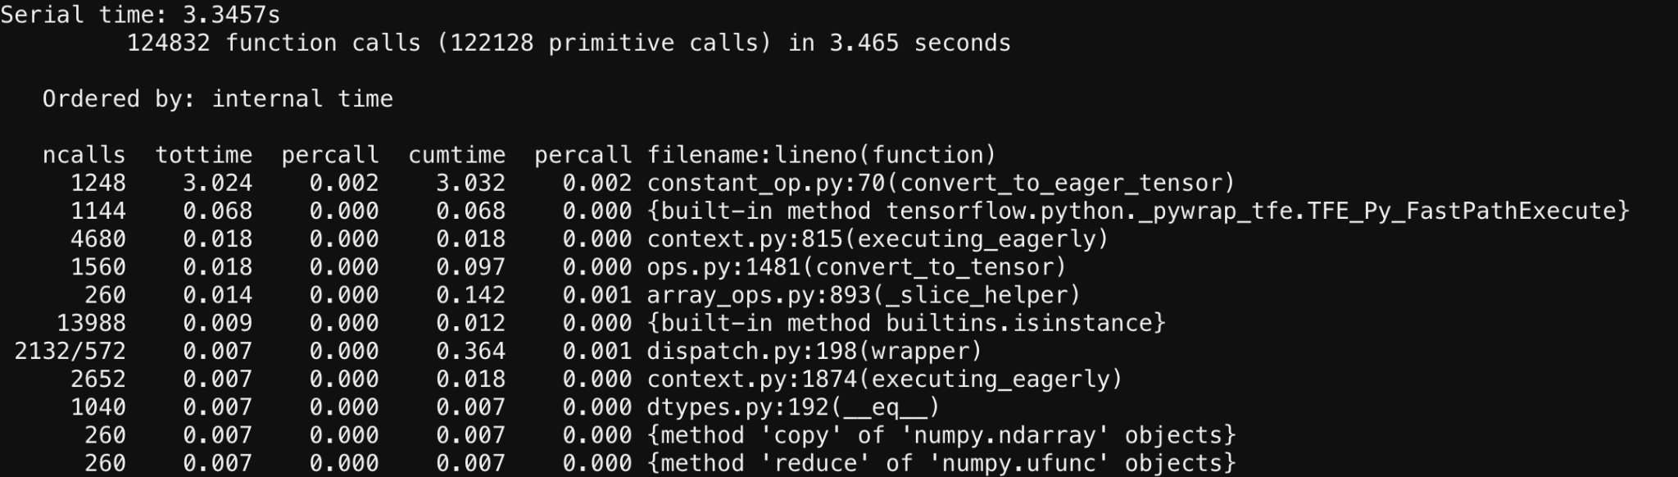
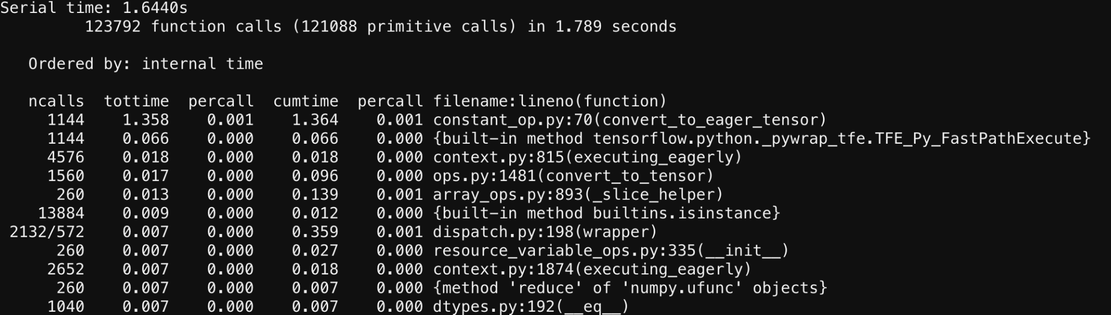
Effective Parallelization
V - Within Node Code Optimization
Optimizing the tf.callbacks on a single process
Code profiling (again!!)
Issue: convert_to_eager_tensor ~90%
Solution: convert_to_eager_tensor of mask outside the tf.callbacks
Result: reduced tf.callbacks runtime by ~50%

Slide 22
Results: Time
VI - Results: Training Results
Training a Single CNN on 4 GPUs:
Serial CPU Timing: 2000 hours
Parallel result: 18 hours
Parallelization of the masking procedure over 10 nodes in a cascade
Serial result: 18h*100 = ~75 days
Parallel result: 18h*2*5 = ~15 days (shootout to Raminder & Francesco who gave us special privileges to allocate all the nodes at once)
Total Training time (taking into account Late Resetting and Masking):
Fully Serial: ~ 8000 days
Parallelization of our solution: ~15 days
Final speed up from single CPU to end-to-end solution: x500

Slide 23
Results: Transfer Learning
VI - Winning Ticket and Transfer learning
Found winning ticket: 12% of the initial architecture
Sparser architecture: computations are ~x6 faster
Generalization across datasets: CIFAR 100
Fine tune our ticket using a low learning rate and 5 epochs. Effective time to train = 11 minutes
Results: Top 5 accuracy 0.82 and top 1 accuracy 0.72
Comparison to a benchmark: retraining MobileNet v2 from scratch on CIFAR 100 for 5 epochs. Effective time to train = ~1 hour
Results Top 5 accuracy 0.41 and top 1 accuracy 0.23
Notes:
Tale

Slide 24
Next Steps
VII - Discussion
Working on more recent NVIDIA GPUs (compute capability >= 7.0), use Mixed Precision policy: expected speed-up x3 (experiment to be tried on AWS)
Further scale the training of one Neural Network: use frameworks for Multi-Node training: Horovod
Find an efficient way to sparsify the underlying computational graph: wait for Tensorflow 3.0?
Notes:
Tale

Slide 25
Thank you for your attention

